Slide 1

InfiniBench: Infinite Benchmarking for Visual Spatial
Reasoning with Customizable Scene Complexity
Haoming Wang, Qiyao Xue, Wei Gao
Department of Electrical and Computer Engineering
University of Pittsburgh

Slide 2
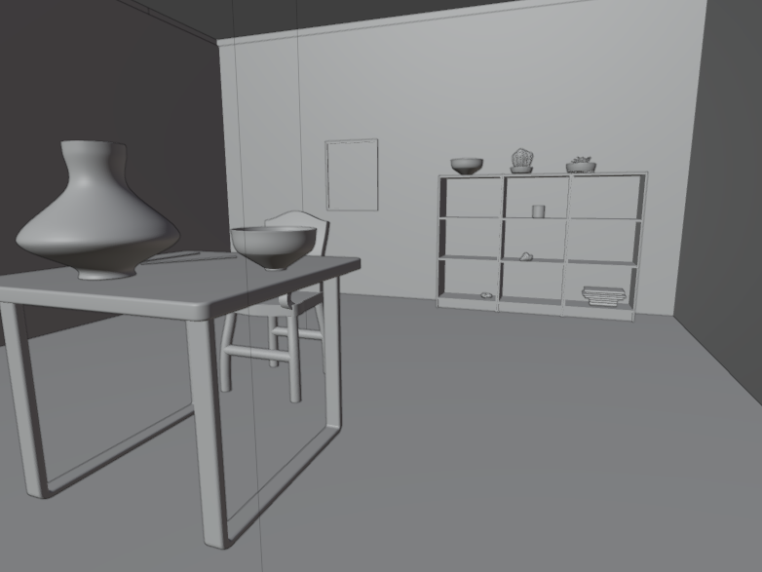
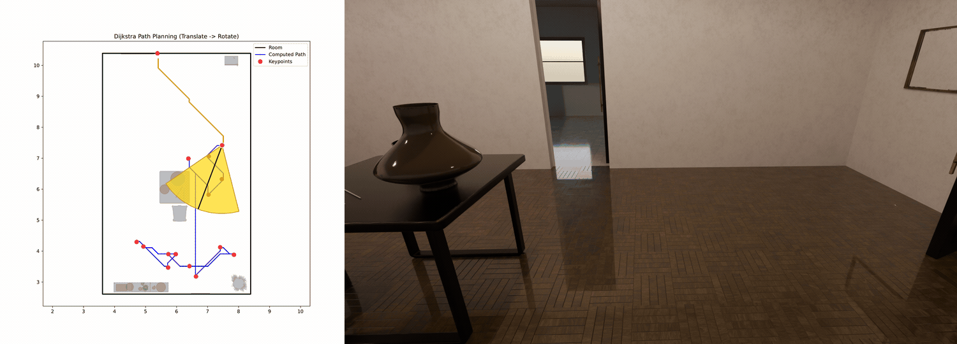
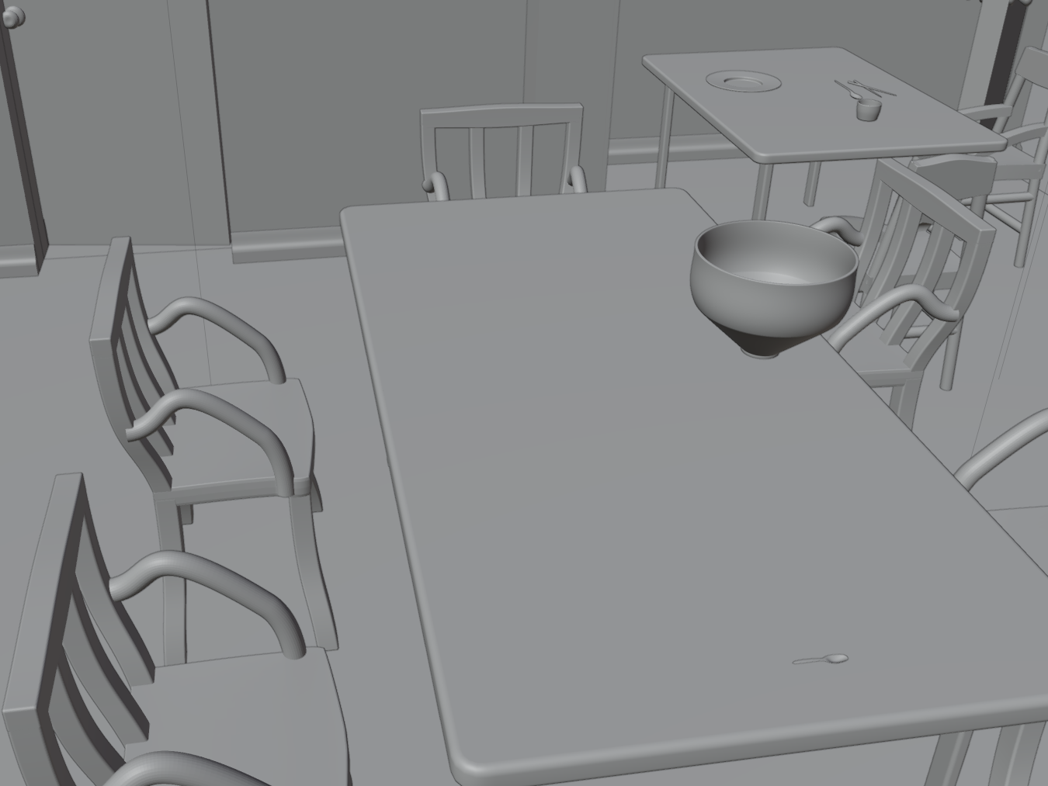
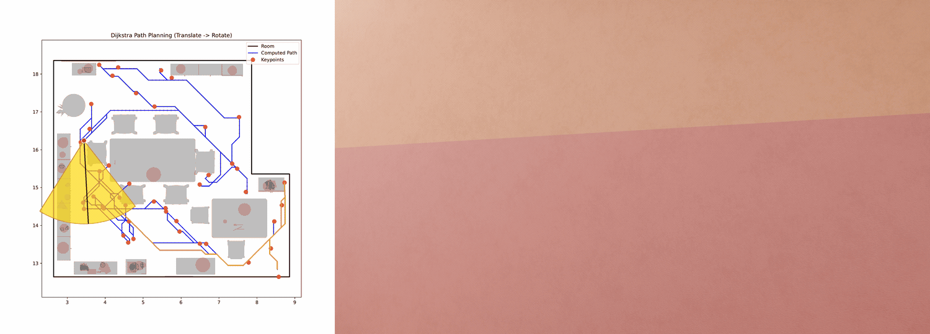
What we do in this paper?
Low
complexity
“A spacious dining room
for one person“
“A furnished, crowded dining room for a big family”
High
complexity

Slide 3
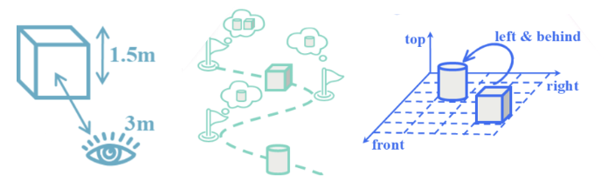
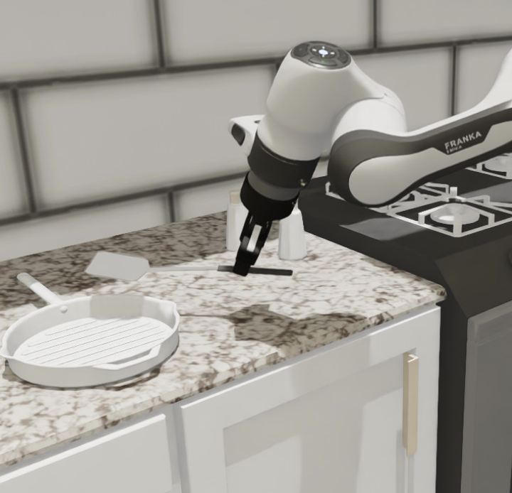
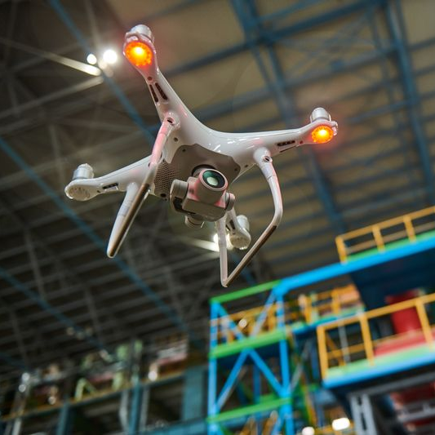
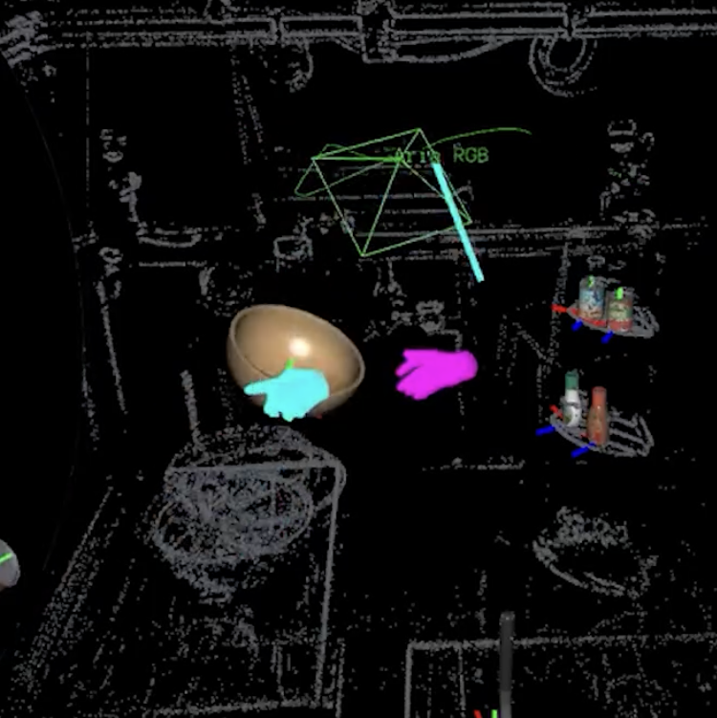
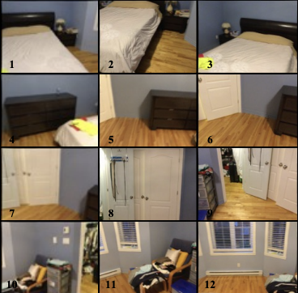
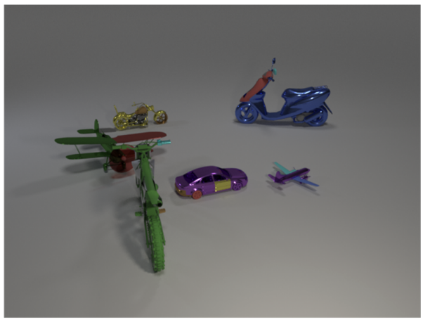
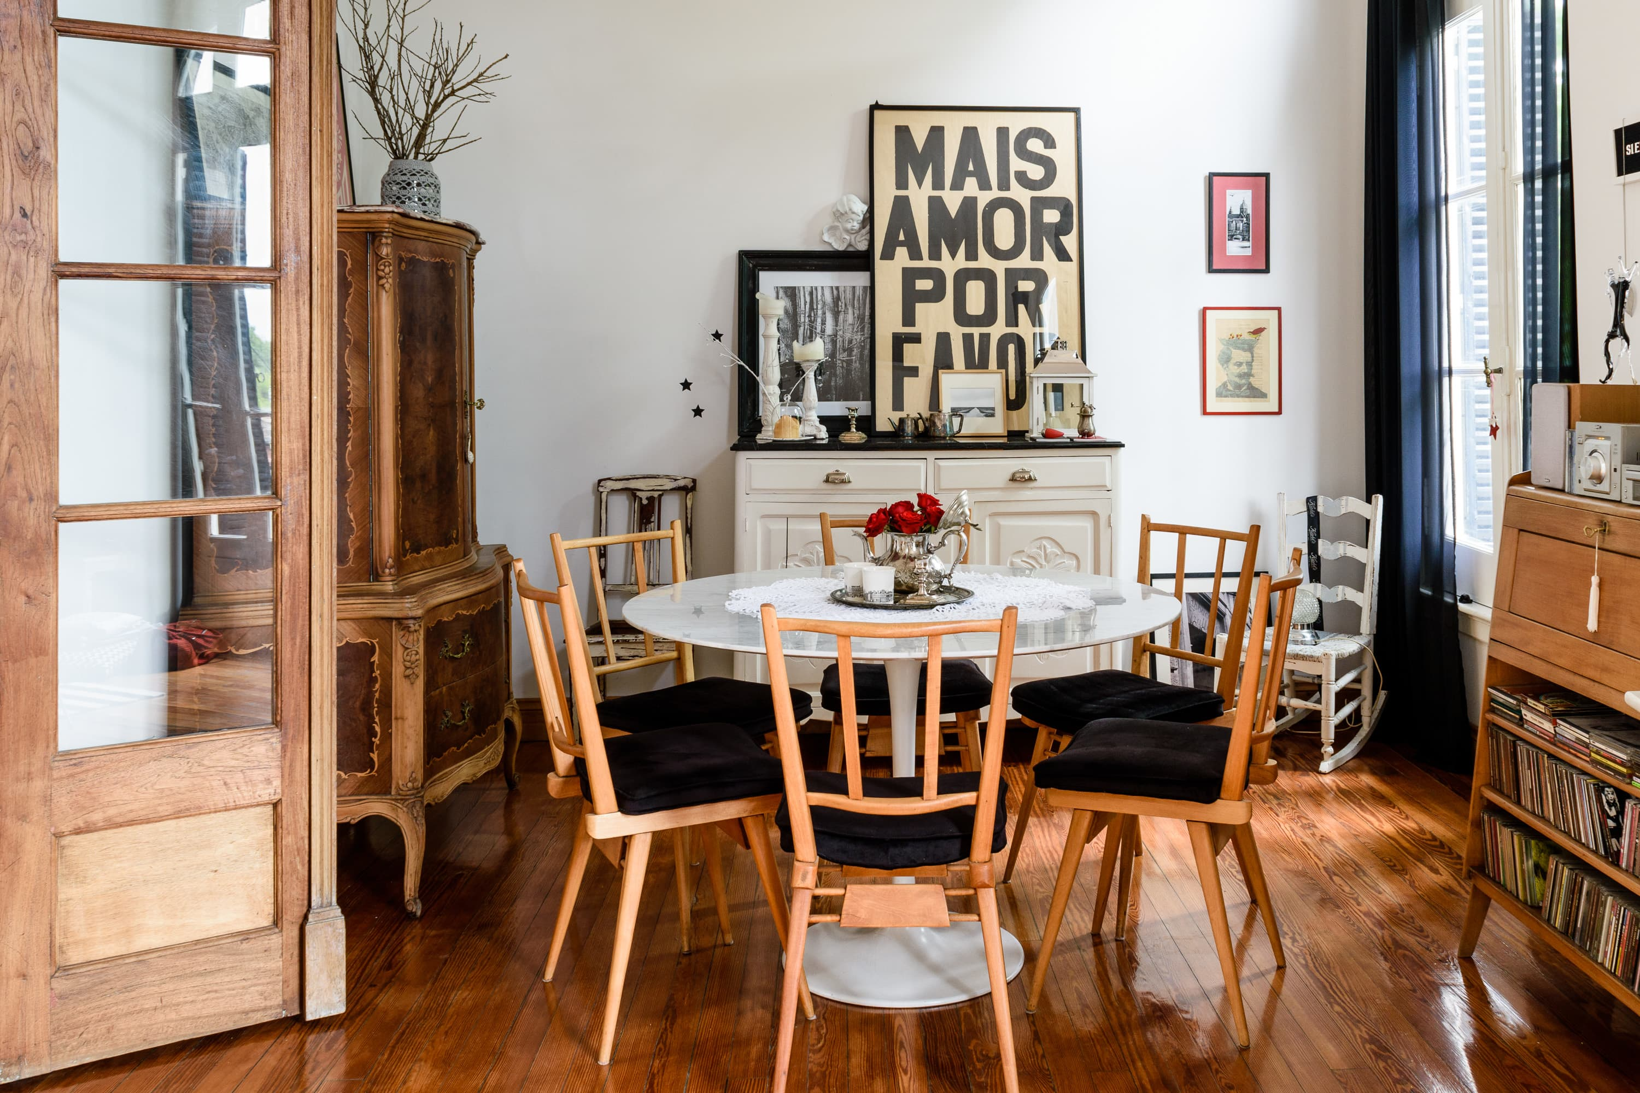


Background and Motivation
Spatial reasoning for VLMs
…
Measurement
Route plan
Spatial relation
Visual input
Spatial questions
Real-world applications
Current VLMs struggle at complex scenes
Why VLMs fail?
Simple scenes
Complex scenes
3

Slide 4
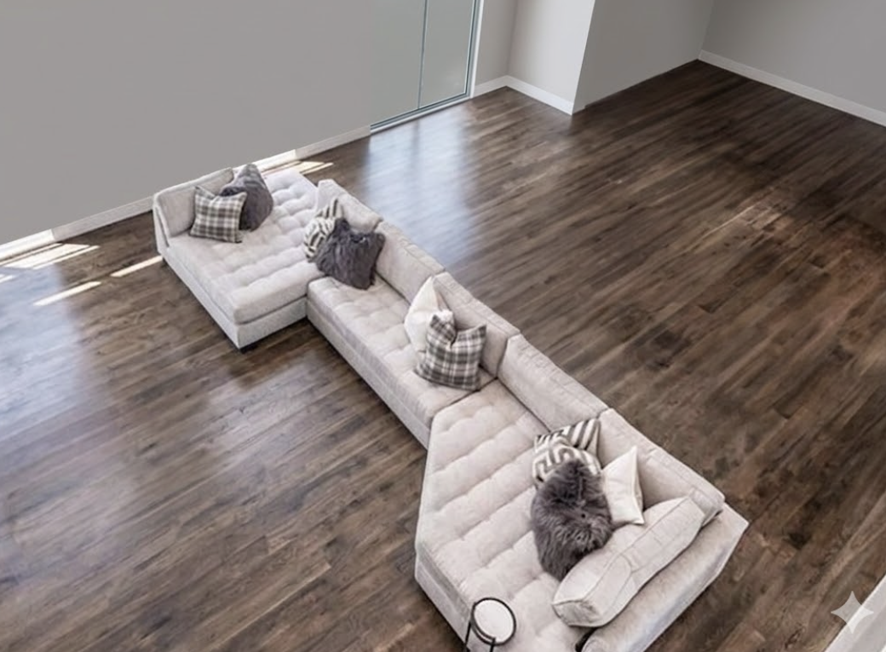
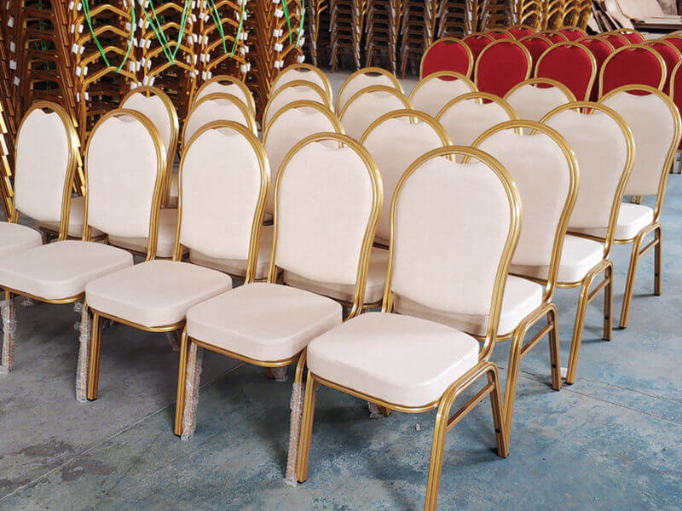
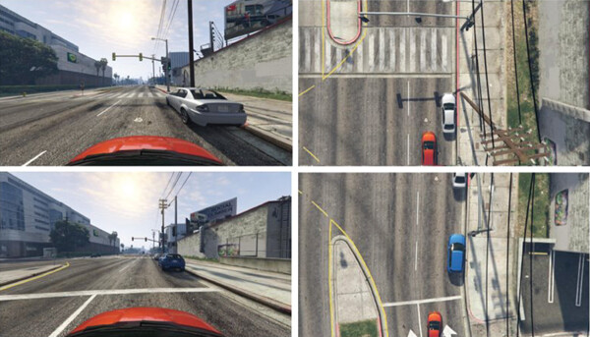
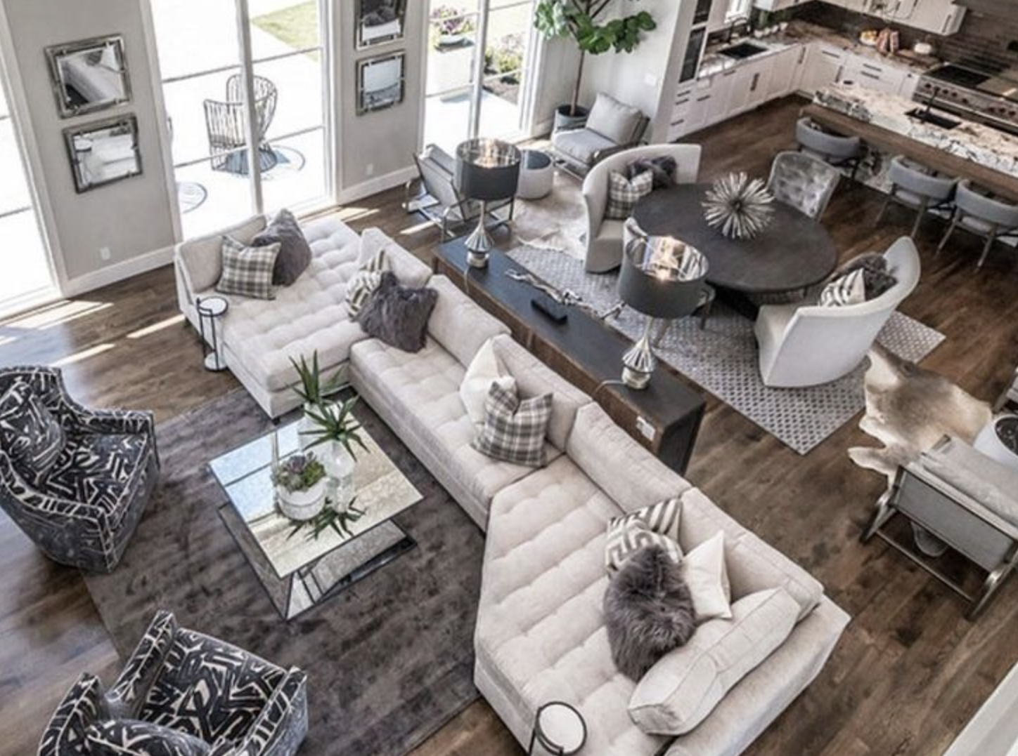
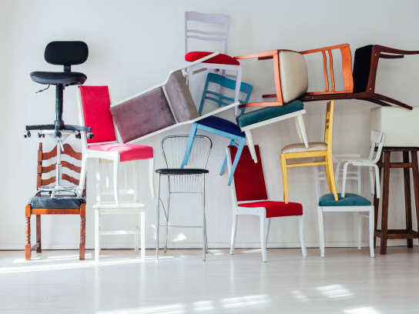
Background and Motivation
Need for benchmark: customizable scene complexity
Compositional complexity
Relational complexity
Observational complexity
Low
complexity
High
complexity
4
4

Slide 5
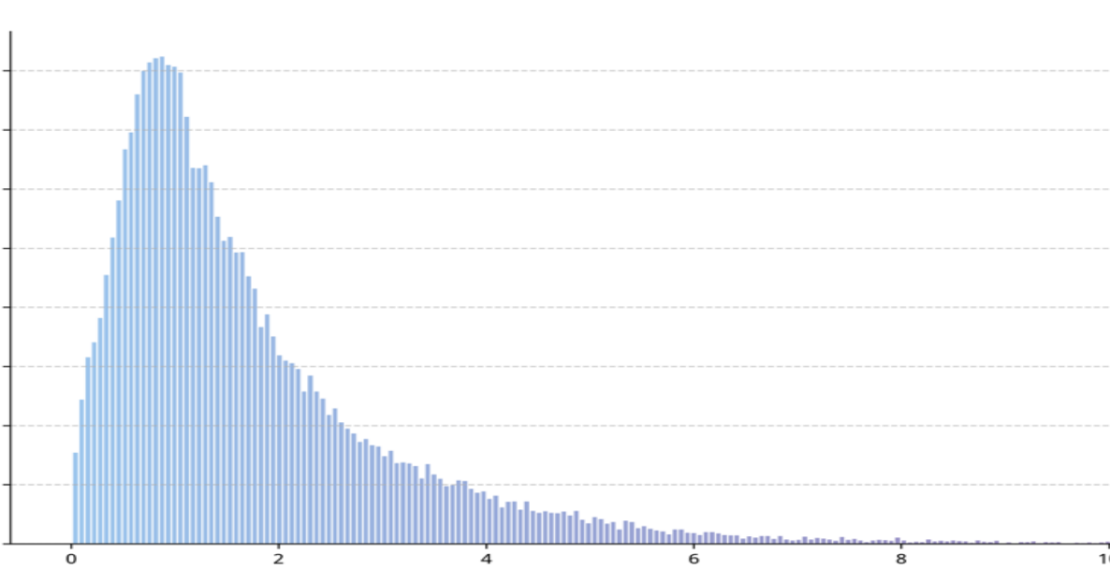
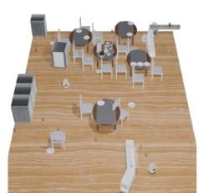
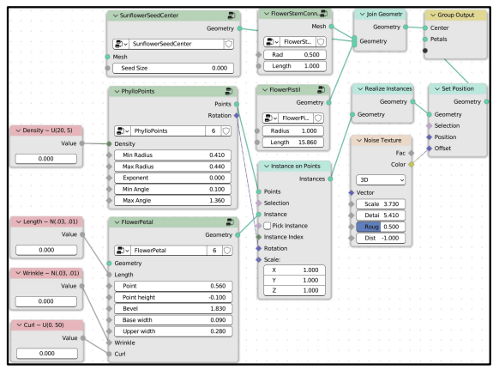
Existing Efforts
Existing work of achieving customizable scene complexity
1. Search in existing real-world datasets
Scene numbers
Lacking scenes with high complexity
Object density
2. Generate synthetic data for specific complexity
LLM-based layout generation
Procedural generation
Generated layouts may be physically invalid
Difficult to use
Fail to generate complex scenes
5

Slide 6









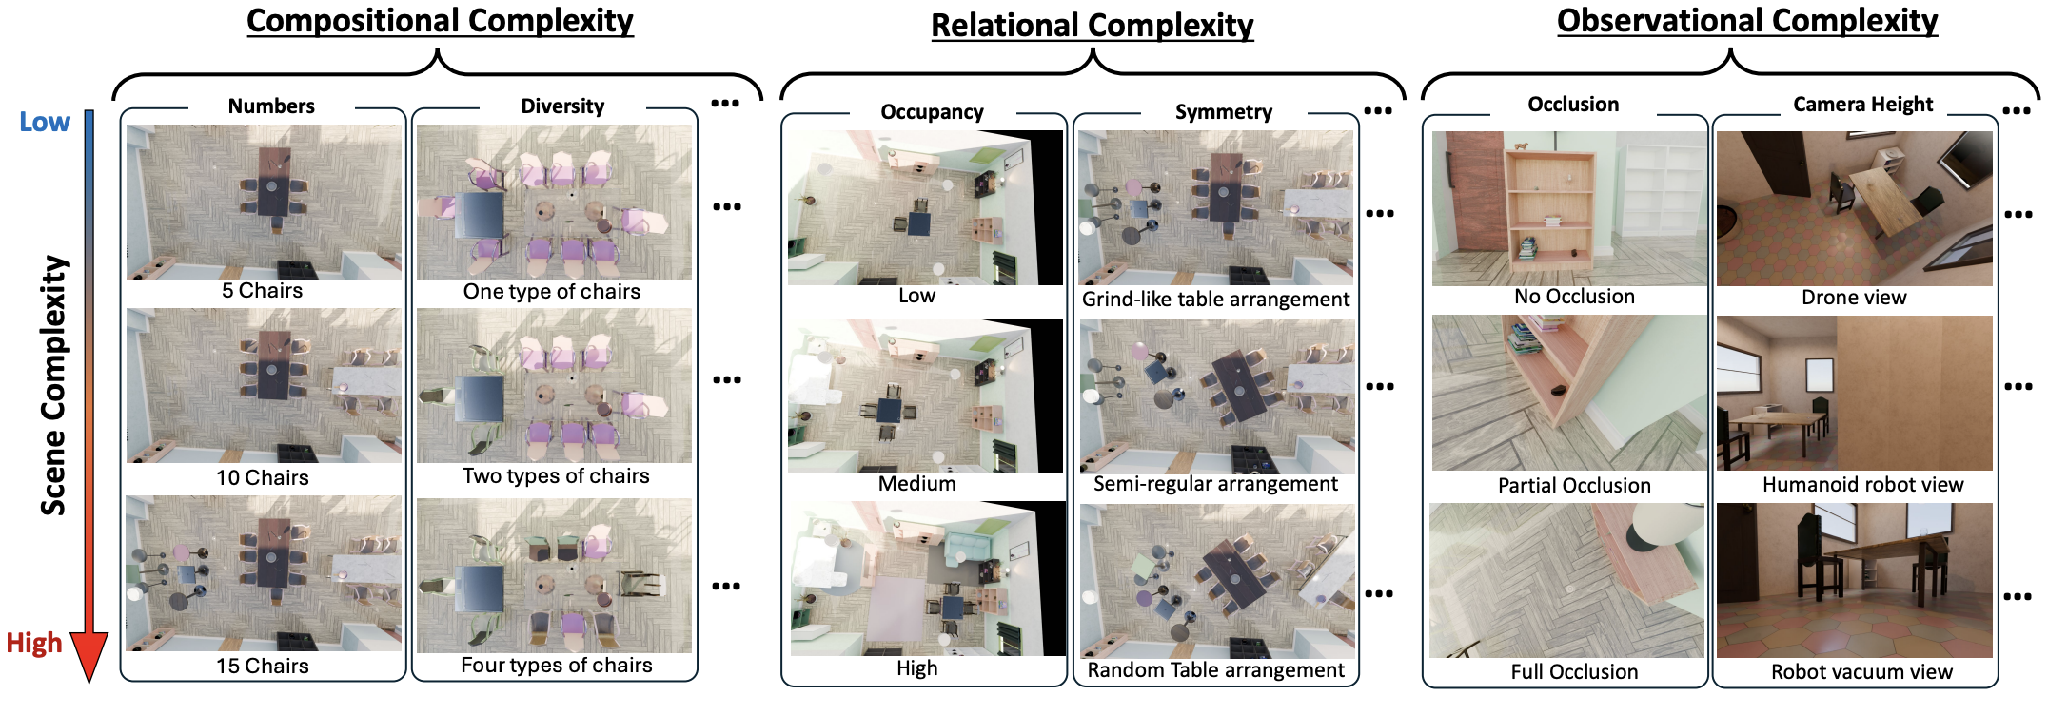
Our Solution: InfiniBench
Scene description
Scene description
Meta data
“A 30 m² dining room containing ten chairs of different types …”
InfiniBench
Layout Optimizer
Compact
layout
Camera trajectory optimizer
QA
Gen
User input
LLM Agent
Room constraint
6

Slide 7





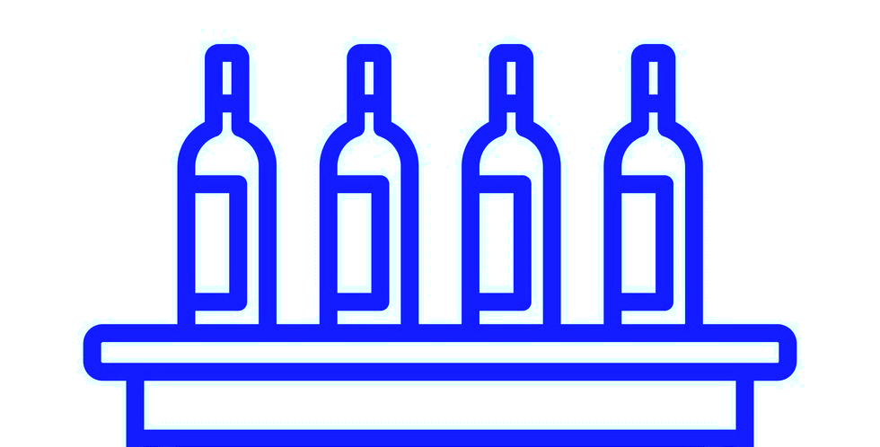
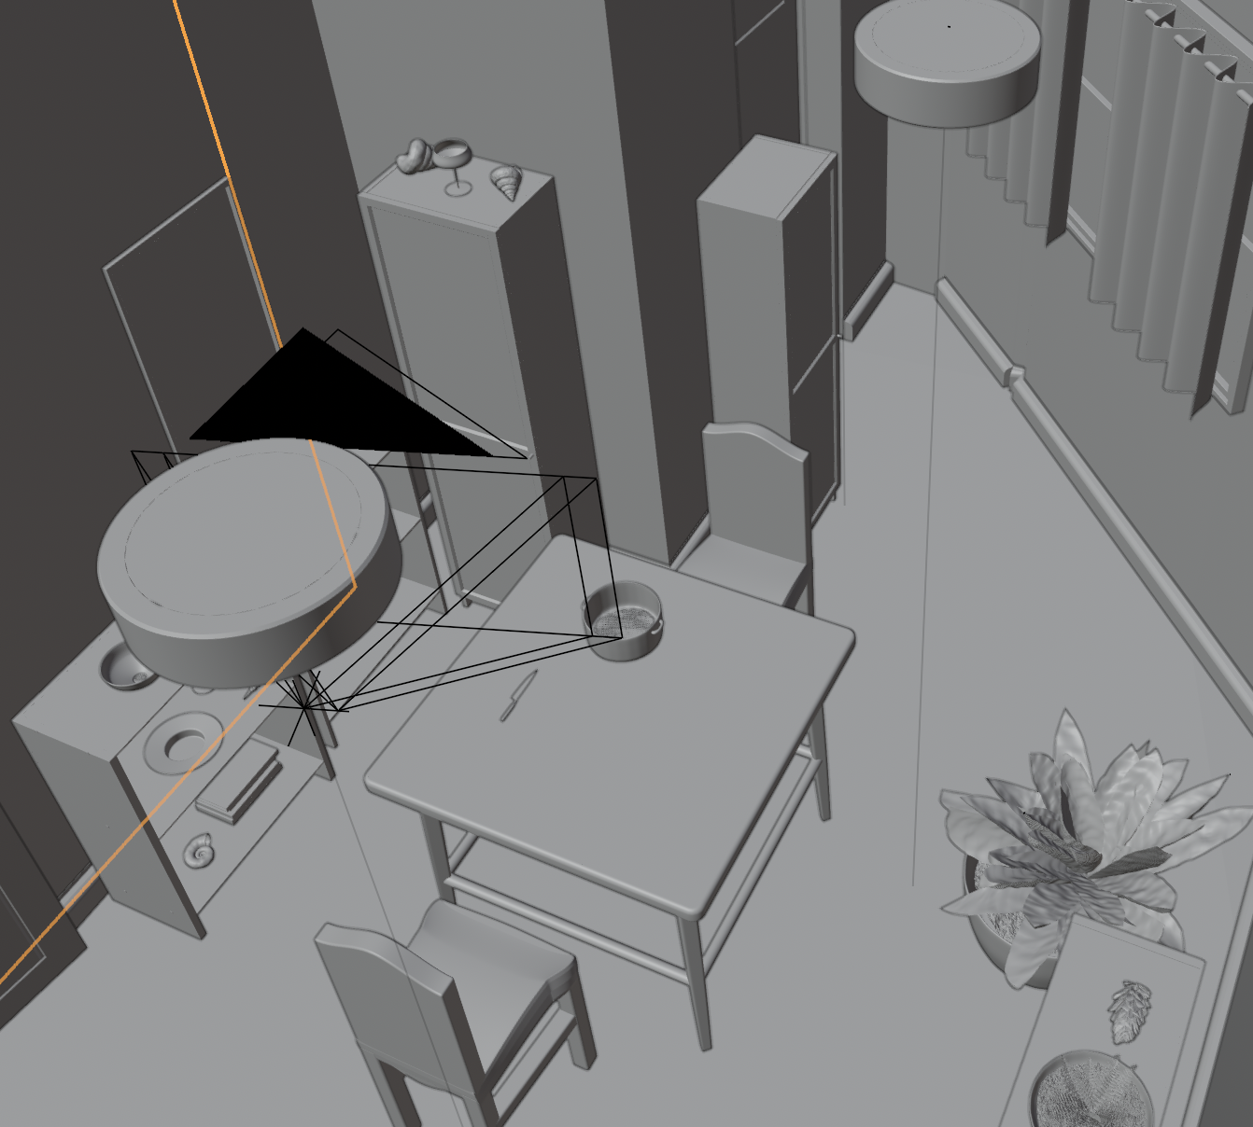

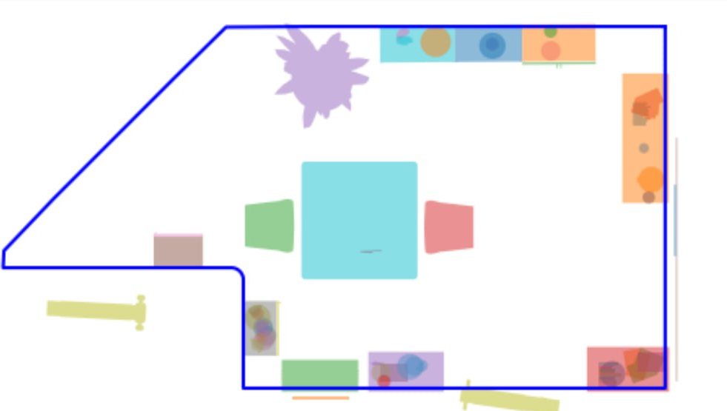



Details of InfiniBench
Scene description
Scene description
Meta data
“A dining room containing ten chairs of different types …”
Layout Optimizer
Compact
layout
Camera trajectory optimizer
QA
Gen
User input
LLM Agent
Room constraint
Scene Complexity description
Generated constraints
LLM
Agent
chair.count().in _range(8,12)
diningtables.related_to(r).all
(diningchairs.related_to(r) …)
Layout Optimizer
Assets
Constraint API list
Refine constraints via CoT reasoning
Scene BEV map and Metadata
Optimized Scene
Room size not enough, increase room size to …
In-context examples
7

Slide 8
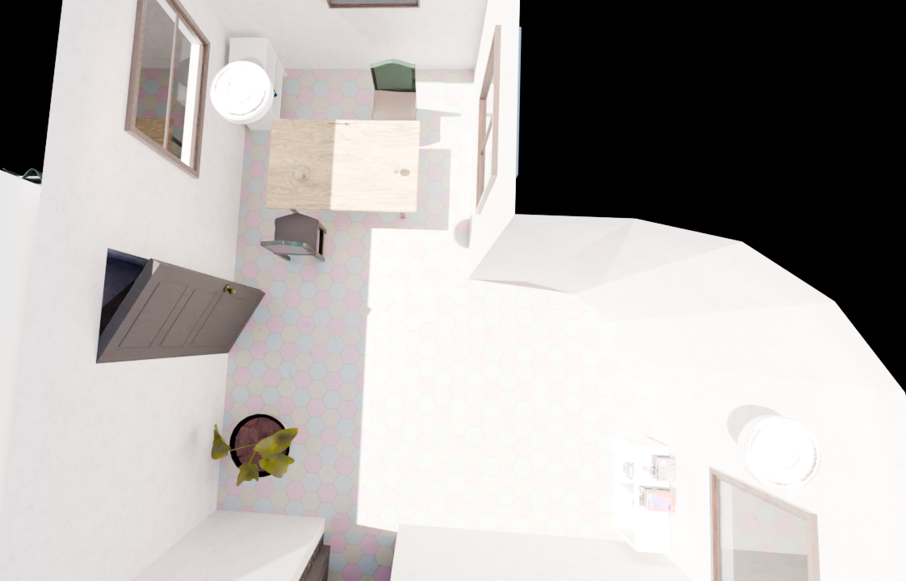


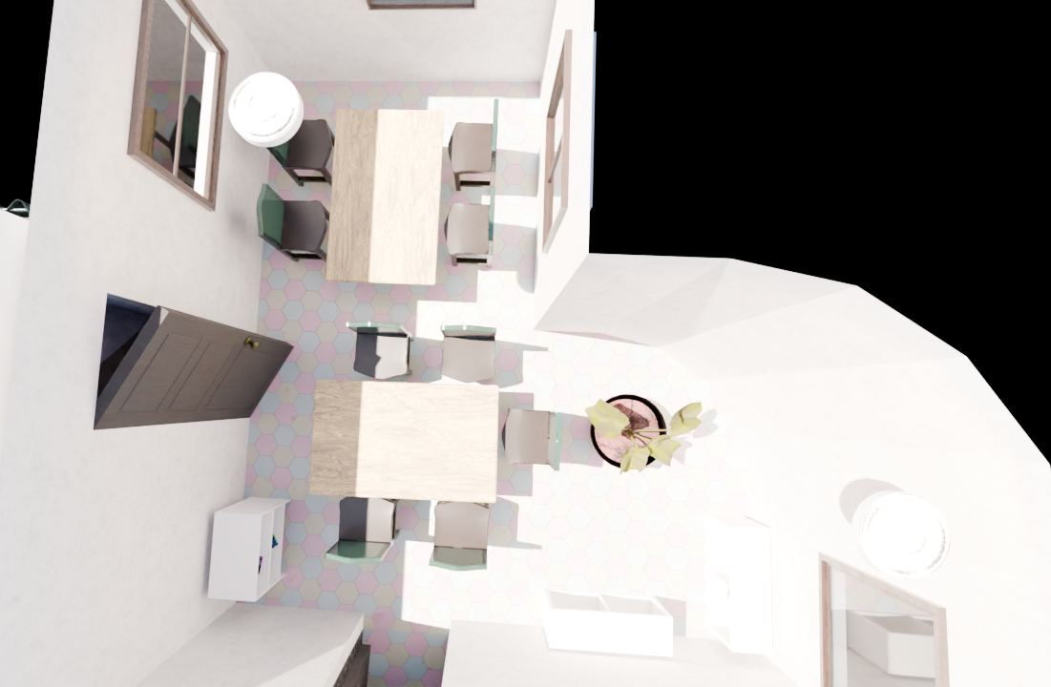


Details of InfiniBench
Scene description
Scene description
Meta data
“A 30 m² dining room containing ten chairs of different types …”
Layout Optimizer
Compact
layout
Camera trajectory optimizer
QA
Gen
User input
LLM Agent
Room constraint
Existing: Optimization with Rigid Hierarchy
Ours: cluster-based optimization
Hierarchical
Fixed
A movable cluster
Ours
8

Slide 9
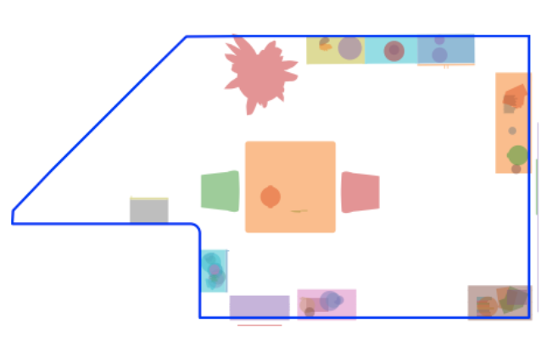

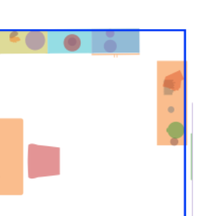
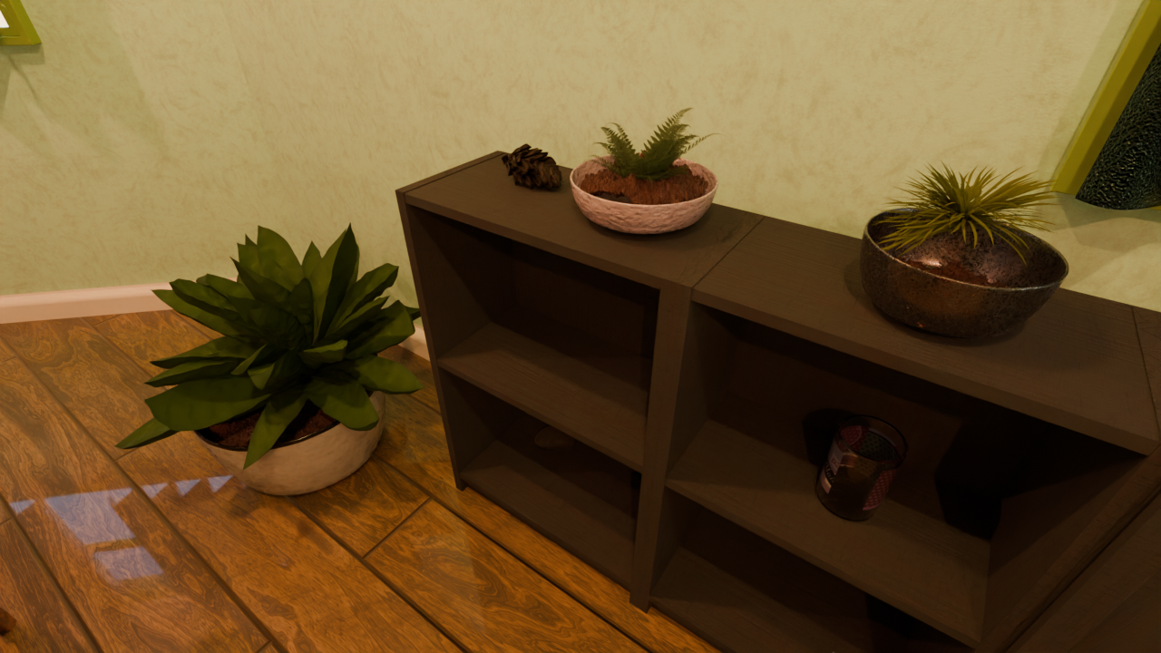

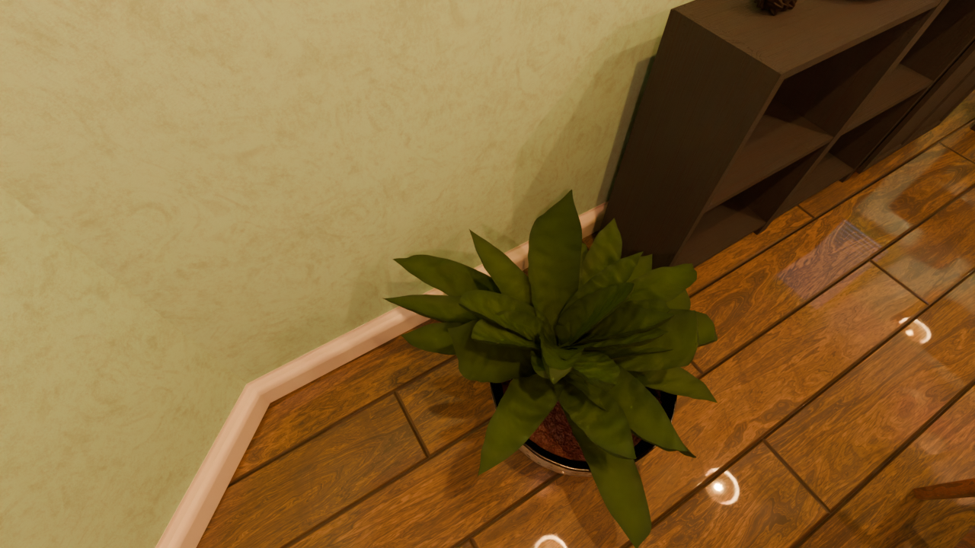
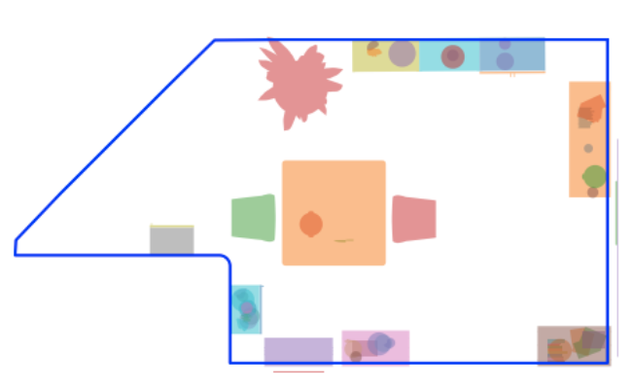
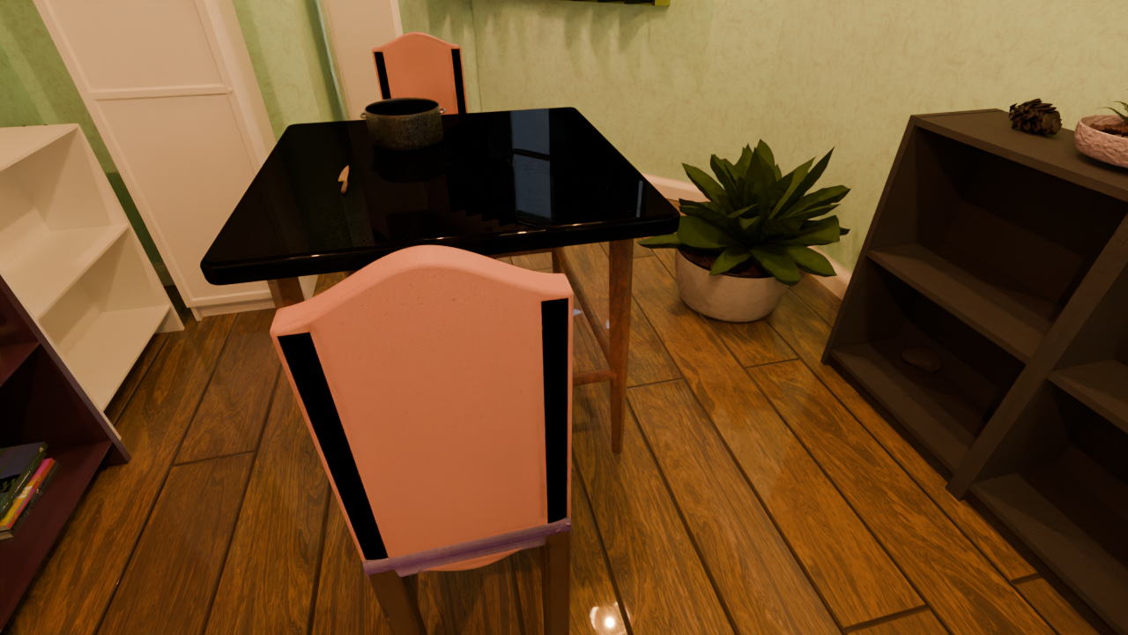
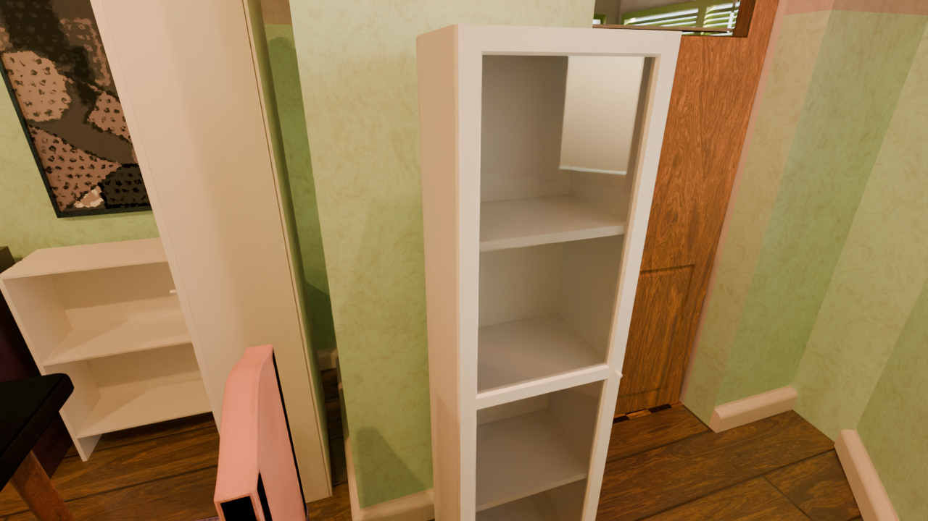

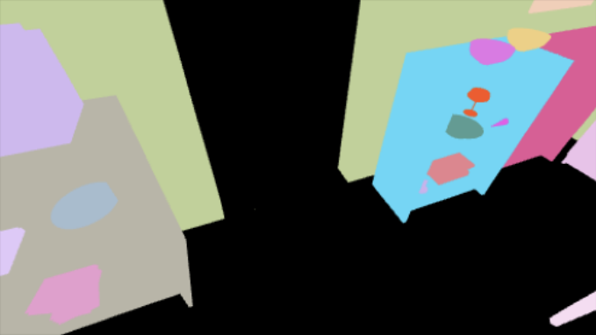
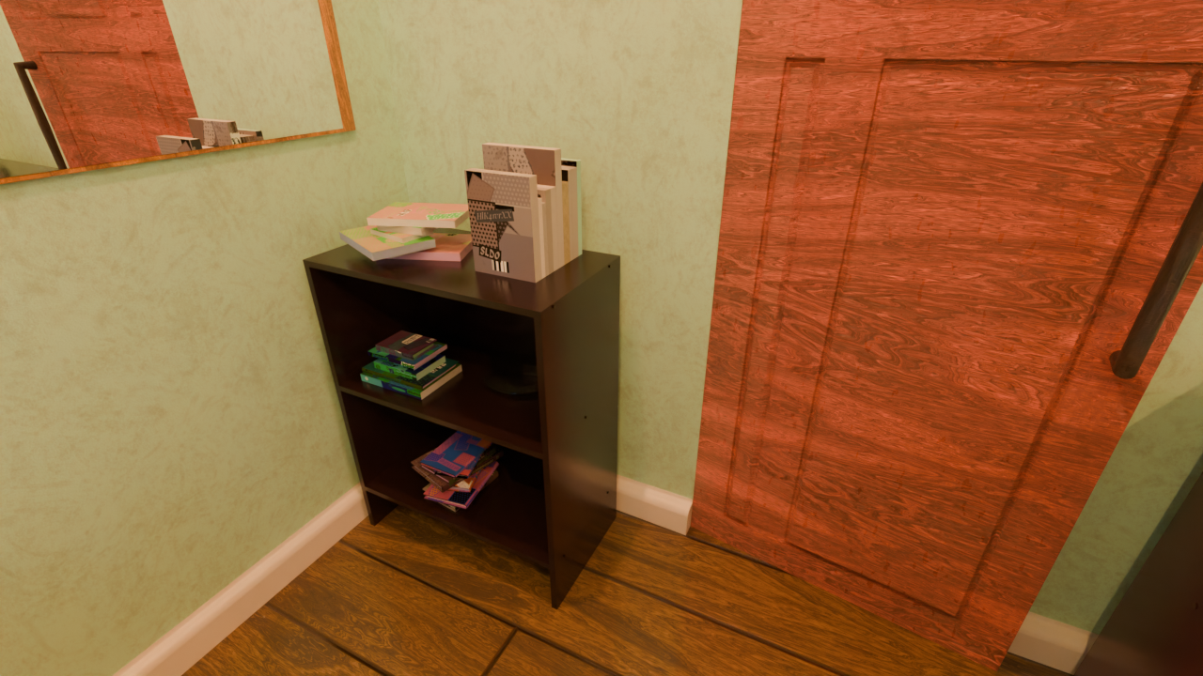
Details of InfiniBench
Scene description
Scene description
Meta data
“A 30 m² dining room containing ten chairs of different types …”
Layout Optimizer
Compact
layout
Camera trajectory optimizer
QA
Gen
User input
LLM Agent
Room constraint
Target object
Current camera
c
①Select target
②Sample Viewpoints
c
⑤ Iteration
Geometric check
- Camera location valid ?
- Object inside FOV?
Occlusion Check
④ Path planning
③ Viewpoint selection
9

Slide 10
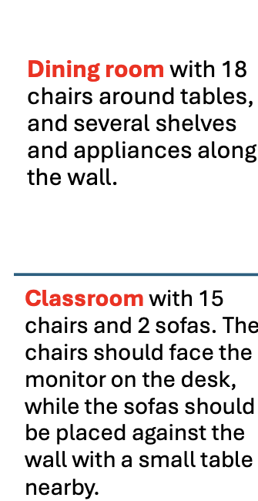
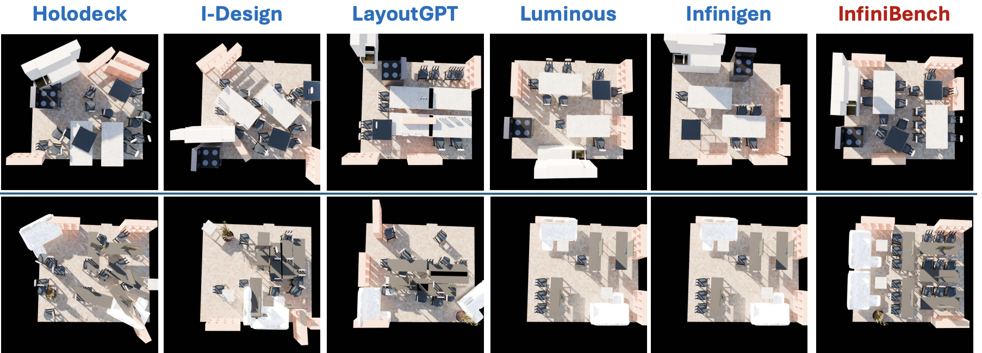
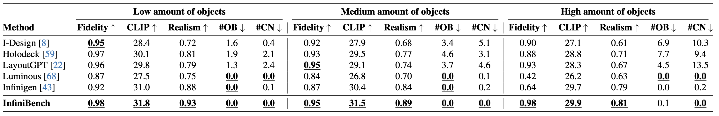
Results of Scene Generation
Unrealistic (overlapped/ out of bound objects)
Not aligned with the description
Fidelity: Measures how well the generated scene matches the text prompt, evaluated by the accuracy of object counts and occupancy ratios relative to the ground truth.
Realism: Evaluates spatial coherence and functional plausibility, scored by GPT5.
Physical plausibility: Quantifies physically impossible artifacts, including out-of-boundary objects (#OB) and object collisions (#CN)
10

Slide 11
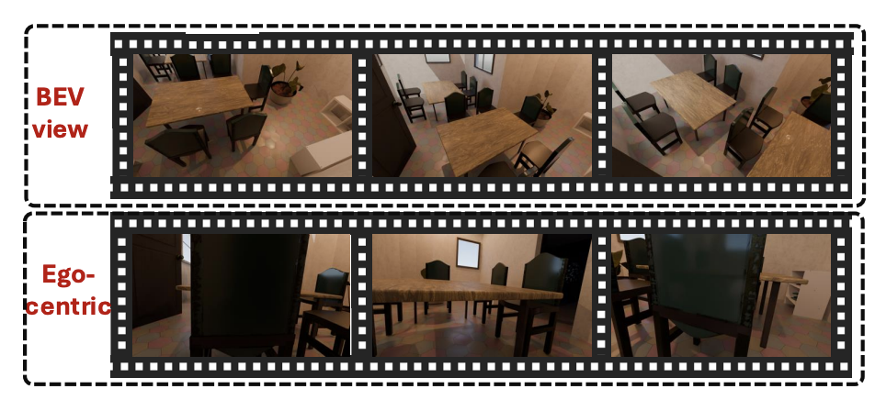
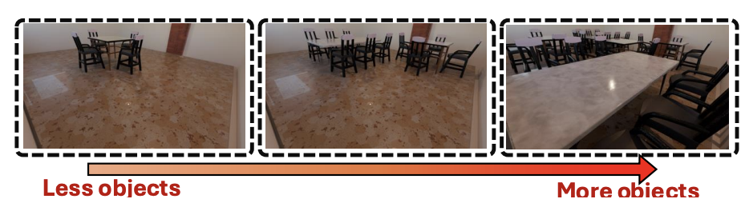
Using InfiniBench to Diagnose VLMs’ Failures in Spatial Reasoning
Compositional Complexity
Observational Complexity
- How does object density hurt scene understanding?
- Does viewpoint affect spatial reasoning?
Evaluated on Gemini-2.5-Pro, GPT-5, LLaVA-Video-7B, InternVL3.5-8B, Cambrian-S-7B
11

Slide 12
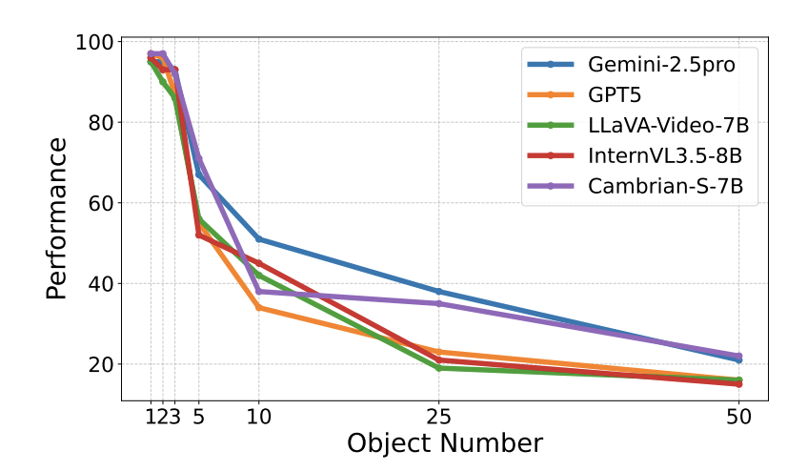
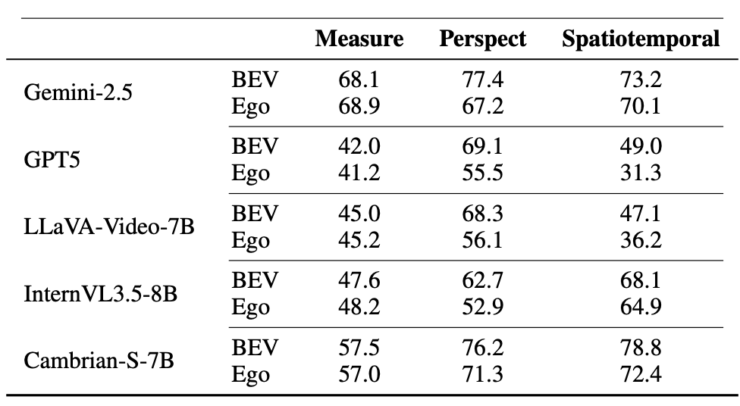
Using InfiniBench to Diagnose VLMs’ Failures in Spatial Reasoning
Compositional Complexity Hurts: VLM accuracy plummets as the number of objects scales from 5 to 50.
The Cause: Models struggle to manage dense visual clutter and frequently fail due to repetitive counting in videos.
Bird’s-Eye View (BEV) is Superior: A higher camera perspective significantly boosts accuracy for Perspective-taking and Spatiotemporal tasks by revealing a clearer layout.
12

Slide 13



Takeaways
InfiniBench:
- Delivers a fully automated, customizable generator for practically infinite 3D spatial benchmarks.
- Successfully bridges natural language expressiveness with procedural physics accuracy.
- Enables fine-grained diagnostic testing of VLMs, isolating exact failure modes.
Paper code:
https://github.com/pittisl/infinibench
Lab homepage:
https://pittisl.github.io/
My personal website
https://haomingwang645.github.io/
13

